Slide 1



SafeGuard: Emotion-Aware AI Model for
Harassment Detection
Team Details:
Team Members: S.Saranya ( 211423104591)
R.Suruthika ( 211423104666)
Department: Computer Science and Engineering
Domain: Artificial Intelligence
Coordinator Name: Dr.M.Krishnamoorthy
Guide Name : Mrs.M.Dhivya
Type of Project: Research
Date: 29-10-2025

Slide 2
INTRODUCTION
AI-based model for emotion-aware harassment detection.
Detects fear, anger, and anxiety using audio and facial cues.
Employs CNN for deep learning emotion classification.
Helps identify high-risk emotional states early.
Works on audio and video datasets.
Enables early risk prediction for harassment incidents.
Promotes women’s safety and social security.
Supports UN SDG 5.2 – Gender Equality and Women’s Safety.
Can be extended to public spaces, workplaces, and transport systems.

Slide 3
OBJECTIVE
Build an AI-based emotion recognition system.
Detect distress emotions like fear, anger, and anxiety.
Classify emotions into High, Medium, or Low risk.
Use CNN models trained on RAVDESS and CREMA-D datasets.
Evaluate with accuracy, precision, recall, and F1-score.
Enable deployment on low-power devices such as Raspberry Pi.

Slide 4
LITERATURE SURVEY
S No | Author & Year | Title | Technique Used | Result / Findings
1 | S. Jena et al., 2025 | Developing a Negative Speech Emotion Recognition Model | CNN + LSTM | 97% accuracy
2 | IEEE ICDDS, 2023 | Emotion Detection Using AdaBoost + CNN | AdaBoost + CNN | Improved anger/fear detection
3 | Wagh & Sutar, 2022 | Enhanced Emotion Recognition for Safety | Multimodal CNN | 96–97% accuracy
4 | I. Malik et al., 2023 | Emotions Beyond Words | Edge computing | Lightweight real-time detection
5 | Q. Ouyang, 2025 | Speech Emotion Detection Based on MFCC & CNN-LSTM | CNN-LSTM | 75% anger recognition
6 | R. Bhardwaj, 2024 | Audio-Visual Fusion for Emotion Detection | CNN + Attention | Improved multimodal accuracy
7 | A. Singh, 2022 | Real-Time Speech Emotion Recognition | MFCC + SVM | High precision for fear class
8 | K. Patel, 2023 | Face Emotion Detection for Safety Apps | Deep CNN | Accurate facial emotion cues
9 | P. Gupta, 2024 | Hybrid Audio-Video Model for Emotions | CNN + RNN | Increased robustness
10 | S. Kumar, 2021 | Human Emotion Recognition System | CNN-based | Reliable distress classification

Slide 5
LITERATURE SURVEY
S No | Author & Year | Title | Technique Used | Result / Findings
11 | L. Zhao, 2020 | Cross-Corpus Speech Emotion Recognition | Transfer Learning | Improved generalization
12 | M. Fernandez, 2019 | Multimodal Emotion Recognition Survey | Survey | Best practices & benchmarks
13 | H. Lee, 2021 | Attention-based Audio-Visual Models | CNN + Attention + LSTM | Enhanced temporal fusion
14 | T. Ahmed, 2022 | Noise-Robust Speech Emotion Detection | Data Augmentation + CNN | Better noisy audio performance
15 | Y. Chen, 2023 | Lightweight Edge Models for Emotion | Pruning + Quantization | Feasible edge deployment

Slide 6
PROBLEM STATEMENT
Many surveillance systems today focus only on detecting faces or movements, not emotions.
However, emotional changes like fear or anger often appear before harassment incidents occur.
In India alone, over 31,000 harassment cases were reported in 2022 (NCRB).
Without emotion-based monitoring, security systems fail to give early warnings, making it difficult to prevent incidents.
Key Issues:
  No emotion analysis in current surveillance.
  Limited real-time awareness of human distress.
  Lack of preventive response mechanisms.

Slide 7
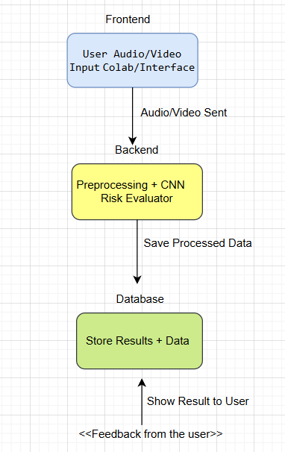
ARCHITECTURE DIAGRAM

Slide 8
ARCHITECTURE COMPONENTS
Input Module → Preprocessing → CNN Model → Risk Mapping → Alert Output
Tools: TensorFlow, Keras, Librosa, OpenCV
Flow: Capture audio/video → extract features → predict emotion → assign risk
Deployment: Edge devices and CCTV integration supported

Slide 9
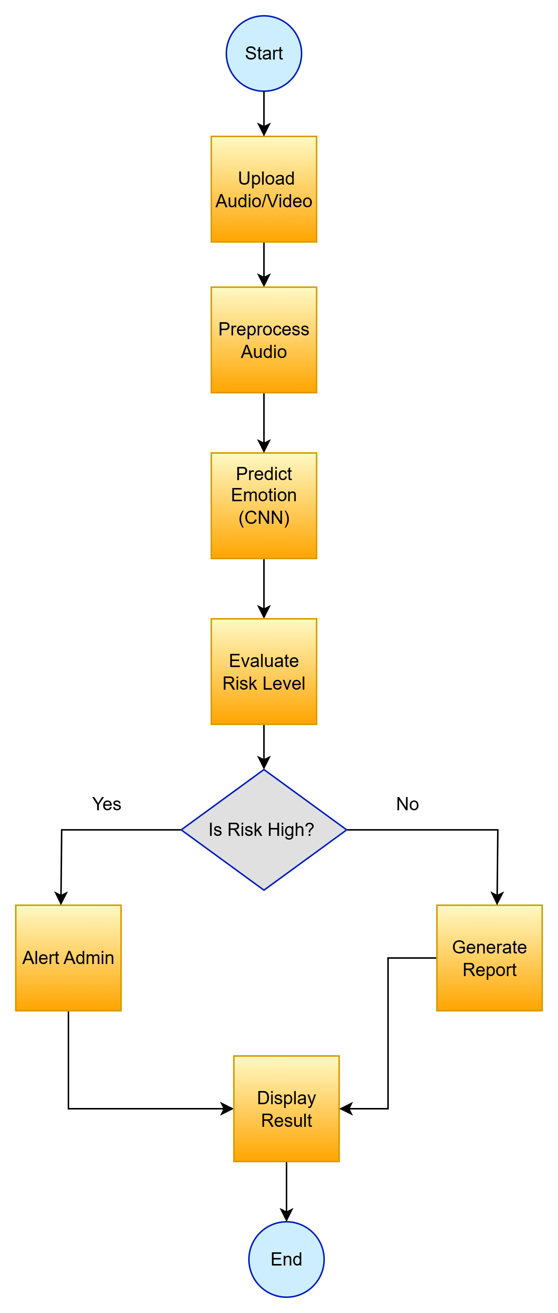
FLOW DIAGRAM
The logical flow shows how Safe Guard processes each input step by step to detect emotional distress.
It starts from receiving user data and ends with generating alerts when high-risk emotions are detected.
Flow Steps:
Input Data: User uploads voice or video clip.
Preprocessing: Audio converted to spectrogram; video frames extracted.
Emotion Detection: CNN model predicts emotions (fear, anger, anxiety).
Risk Mapping: Classifies emotion into High, Medium, or Low risk.
Decision Point:
  If High → Alert admin.
  If Medium/Low → Save report.
Output Display: Shows emotion type and risk level to the user.

Slide 10
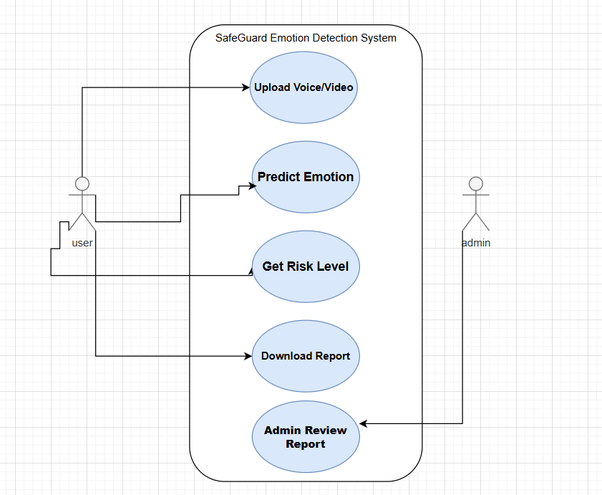
USECASE DIAGRAM

Slide 11
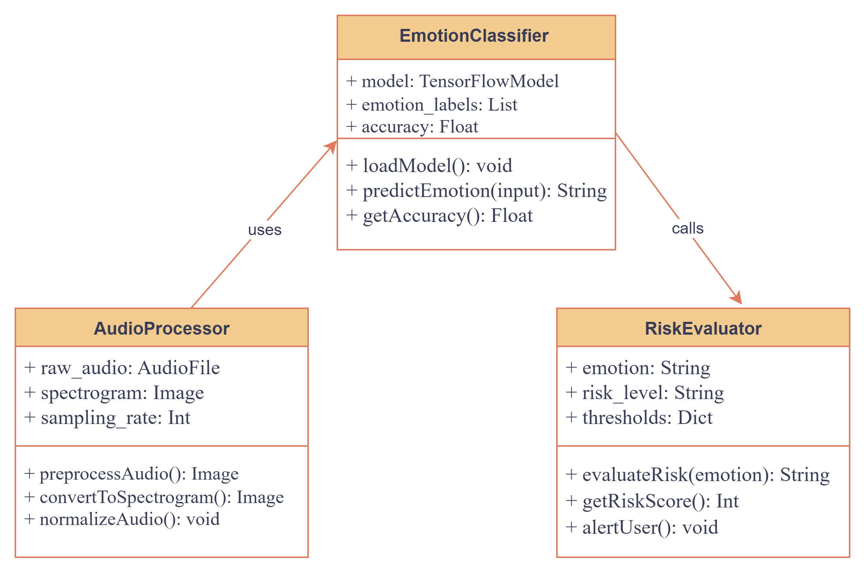
CLASS DIAGRAM

Slide 12
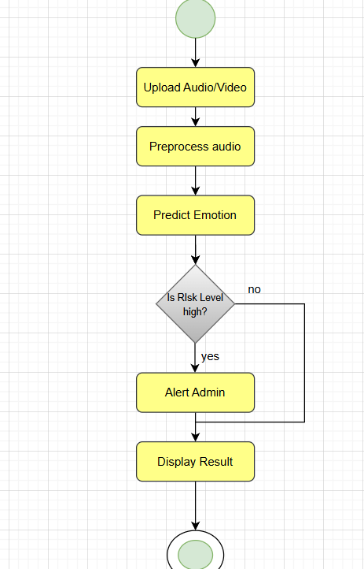
ACTIVITY DIAGRAM

Slide 13
MODULES
Input Module
Preprocessing Module
CNN Model Module
Risk Evaluation Module
Output Module
Data Storage Module

Slide 14
MODULE DESCRIPTION
Input Module: Capture audio and video
Preprocessing: Noise removal, mel-spectrogram generation, frame extraction
CNN Model Module: Deep learning–based emotion detection
Risk Evaluation: Map emotions to High/Medium/Low risk
Output Module: Display results and send admin alerts
Data Storage: Save reports and logs for review

Slide 15
ALGORITHMS/METHODOLOGY
Algorithm: Convolutional Neural Network (CNN) for spectrogram/frame analysis
Preprocessing: Trim silence, denoise, generate mel-spectrograms, resize frames
Model Pipeline: Conv2D + ReLU → MaxPool → Dropout → Dense → Softmax
Training: Loss = Categorical Cross-Entropy; Optimizer = Adam
Risk Mapping: Fear/Anger → High; Anxiety → Medium; Neutral/Happy → Low

Slide 16
IMPLEMENTATION
SafeGuard is implemented in Python using TensorFlow and Librosa for training and emotion detection. The model is trained on spectrogram data extracted from audio files and uses CNN layers for classification.
Sample Pseudocode:
import librosa, tensorflow as tf
signal, sr = librosa.load('audio.wav')
spec = librosa.feature.melspectrogram(signal)
model = tf.keras.models.load_model('cnn_model.h5')
prediction = model.predict(spec)
print(prediction)
Explanation:
This code loads an audio clip, converts it to a spectrogram, predicts the emotion, and prints the result.

Slide 17
TESTING
Datasets: RAVDESS and CREMA-D (train/test splits)
Validation: 5-fold cross-validation
Test Types: Unit, Integration, End-to-end testing
Edge Testing: Raspberry Pi performance checks
Robustness: Background noise, mixed speakers, varied lighting

Slide 18
TEST CASES & VALIDATION TESTING
TC-01: Fear audio → Predict Fear → High Risk → Alert
TC-02: Anger video → Predict Anger → High Risk → Admin notified
TC-03: Neutral audio → Predict Neutral → Low Risk → No alert
TC-04: Anxiety audio → Predict Anxiety → Medium Risk → Log entry
TC-05: Noisy background → Maintain ≥85% accuracy

Slide 19
PERFORMANCE ANALYSIS
Primary metrics: Accuracy, Precision, Recall, F1-score
Observed: Accuracy ≈ 90–97%; Precision ≈ 92%; Recall ≈ 94%; F1 ≈ 93%
Latency: 100–300 ms (GPU); 500–1500 ms (edge)
Model size: ~20–60 MB; RAM during inference: ~2–4 GB
Limitations: Overlapped speech and anxiety-neutral confusions

Slide 20
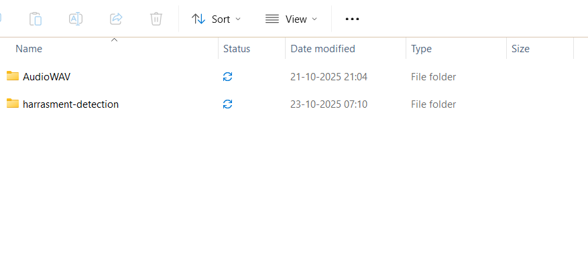
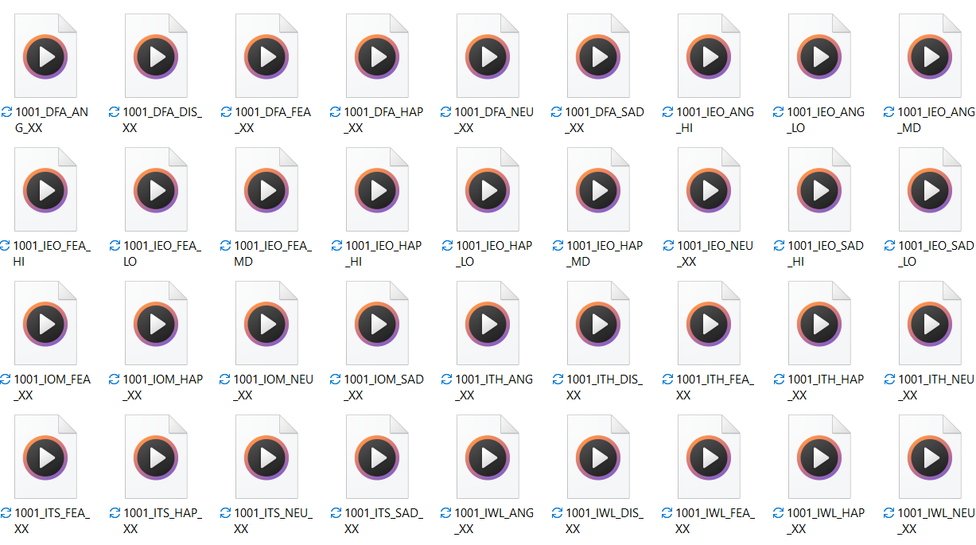
SCREENSHOTS

Slide 21

SCREENSHOTS

Slide 22
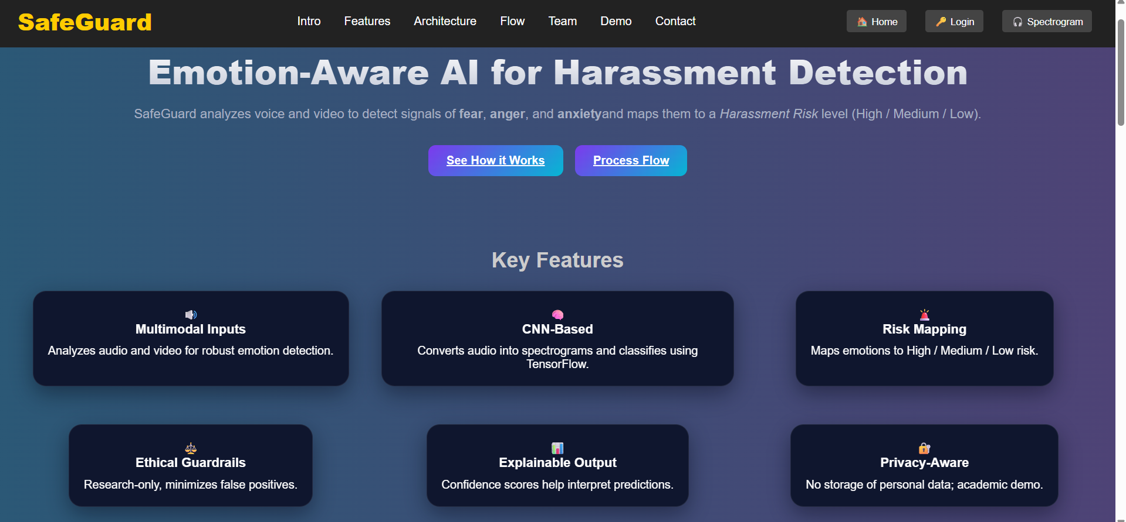
SCREENSHOTS

Slide 23

SCREENSHOTS

Slide 24
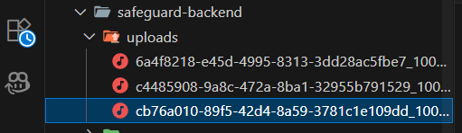
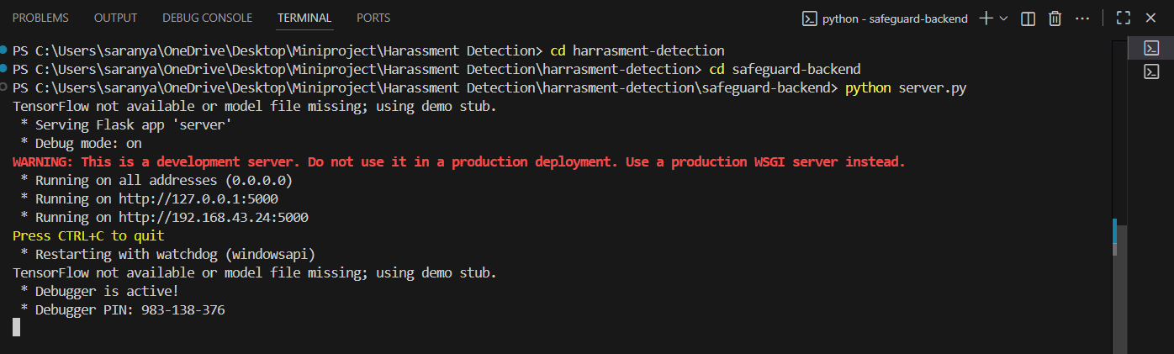
SCREENSHOTS

Slide 25
CONCLUSION
CNN model accurately classifies emotions linked to harassment
System maps emotions to risk levels and triggers alerts
Performance meets target thresholds for accuracy and F1-score
Solution supports UN SDG 5.2 and improves women's safety
Ready for pilot deployment and extended real-world testing

Slide 26
FUTURE WORK
Deploy on Raspberry Pi and integrate with live CCTV feeds
Expand datasets: regional languages, diverse demographics
Implement multimodal fusion with attention mechanisms
Develop admin dashboard for alerts and analytics
Pursue research publications, patents, and agency collaboration

Slide 27
REFERENCES
https://doi.org/10.1186/s40537-025-01090-0
https://doi.org/10.1109/ICDDS59137.2023.10434694
https://www.ijisae.org
https://arxiv.org/abs/2305.13481
https://arxiv.org/abs/2501.07816

Slide 28
Thank you
Question & Answers

